Slide 1

Chapter 9
Introduction to Data-Link Layer
School of Computer Science and Engineering
Pusan National University
Jeong Goo Kim

Slide 2
Ch. 9 Outline
    Outline
9.1 Introduction
9.2 Link-Layer Addressing

Slide 3
    Ch. 9 Objective
    Objective
defining the concept of links and nodes
  the services provided by the data-link layer
  point-to-point and broadcast links
  two sub-layers at the data-link layer
link-layer addressing
  rationale behind the existence of an addressing mechanism at the data-link layer
  three types of link-layer addresses
  Address Resolution Protocol (ARP)

Slide 4
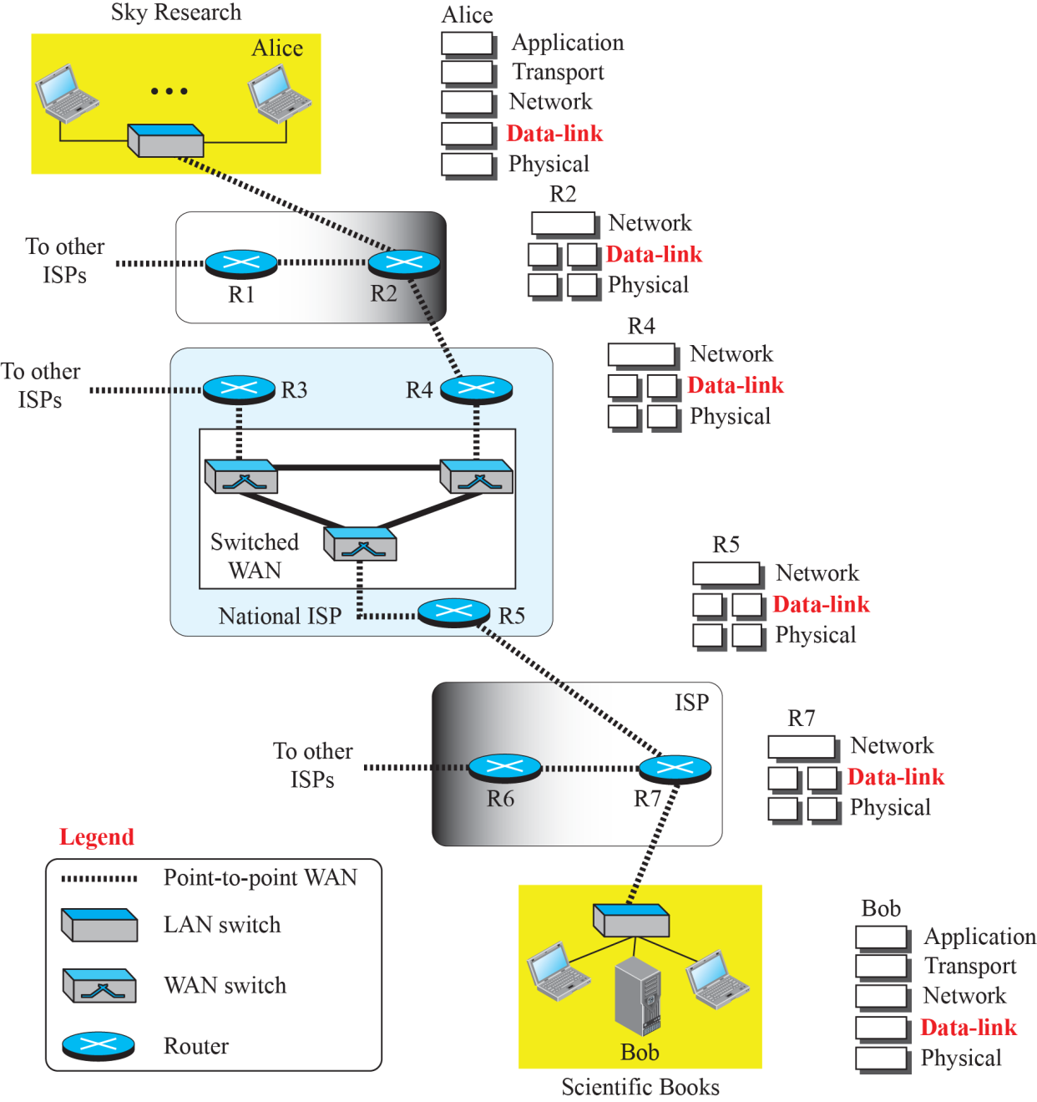
    9.1 Introduction
    9.1 Introduction
Fig. 9.1 Communication at the data-link layer

Slide 5
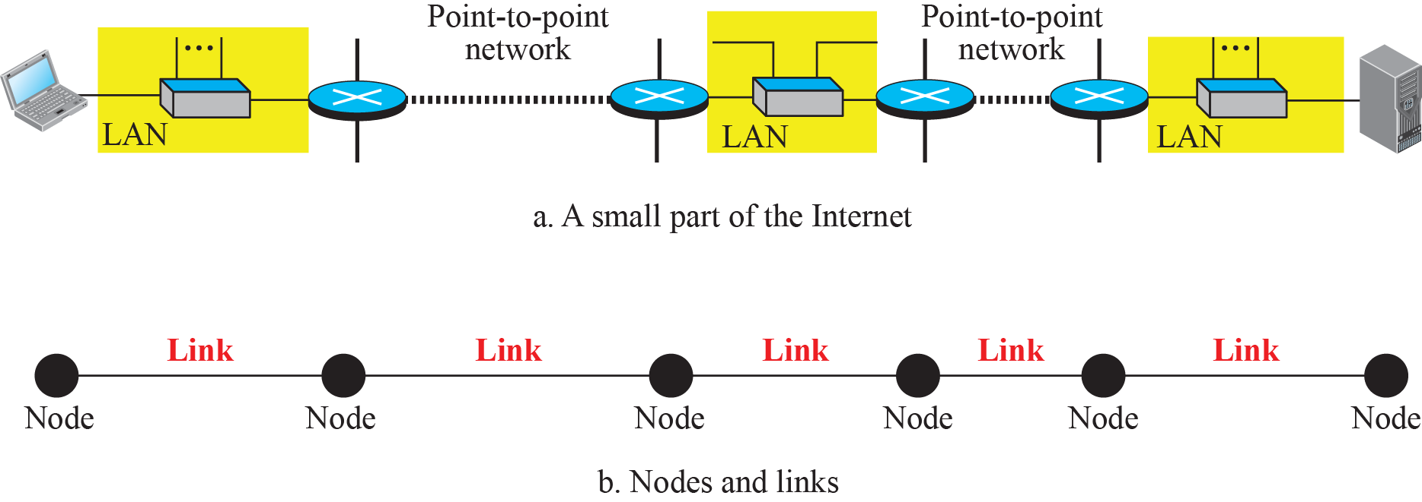
    9.1 Introduction
    9.1.1 Nodes and Link
Communication at the data-link layer is node-to-node.
LANs and WANs are connected by routers.
It is customary to refer to the two end hosts and the routers as nodes and the networks in between as links.
Fig. 9.2 Nodes and Links

Slide 6
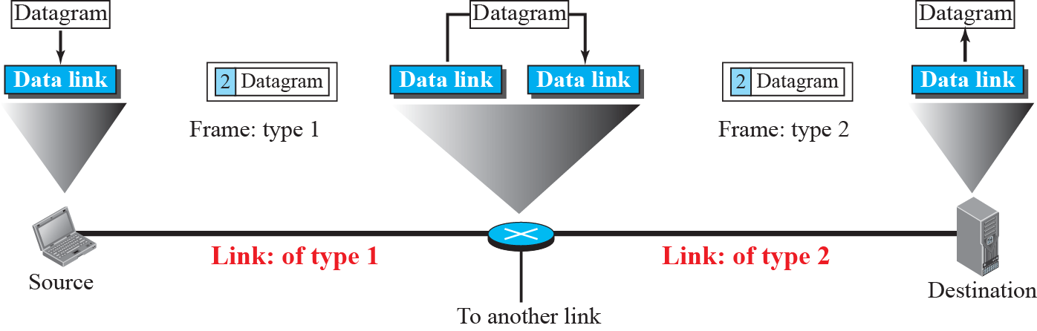
    9.1 Introduction
    9.1.2 Services
The data-link layer provides services to the network layer; it receives services from the physical layer.
  Framing
  Flow Control
  Error control
  Congestion Control
Fig. 9.3 A communication with only three nodes

Slide 7
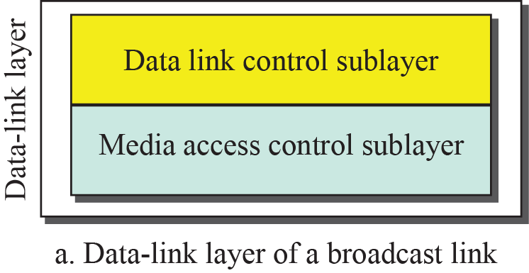
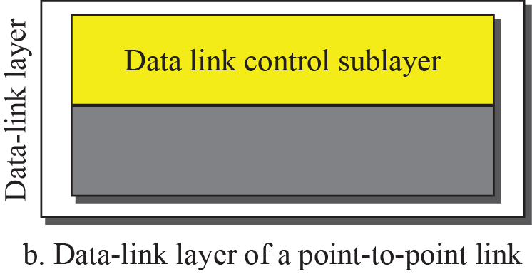
    9.1 Introduction
    9.1.3 Two Categories of Links
a point-to-point link.
a broadcast link.
    9.1.4 Two Sublayer
data link control (DLC)
media access control (MAC).
Fig. 9.4 Dividing the data-link layer into two sublayers

Slide 8
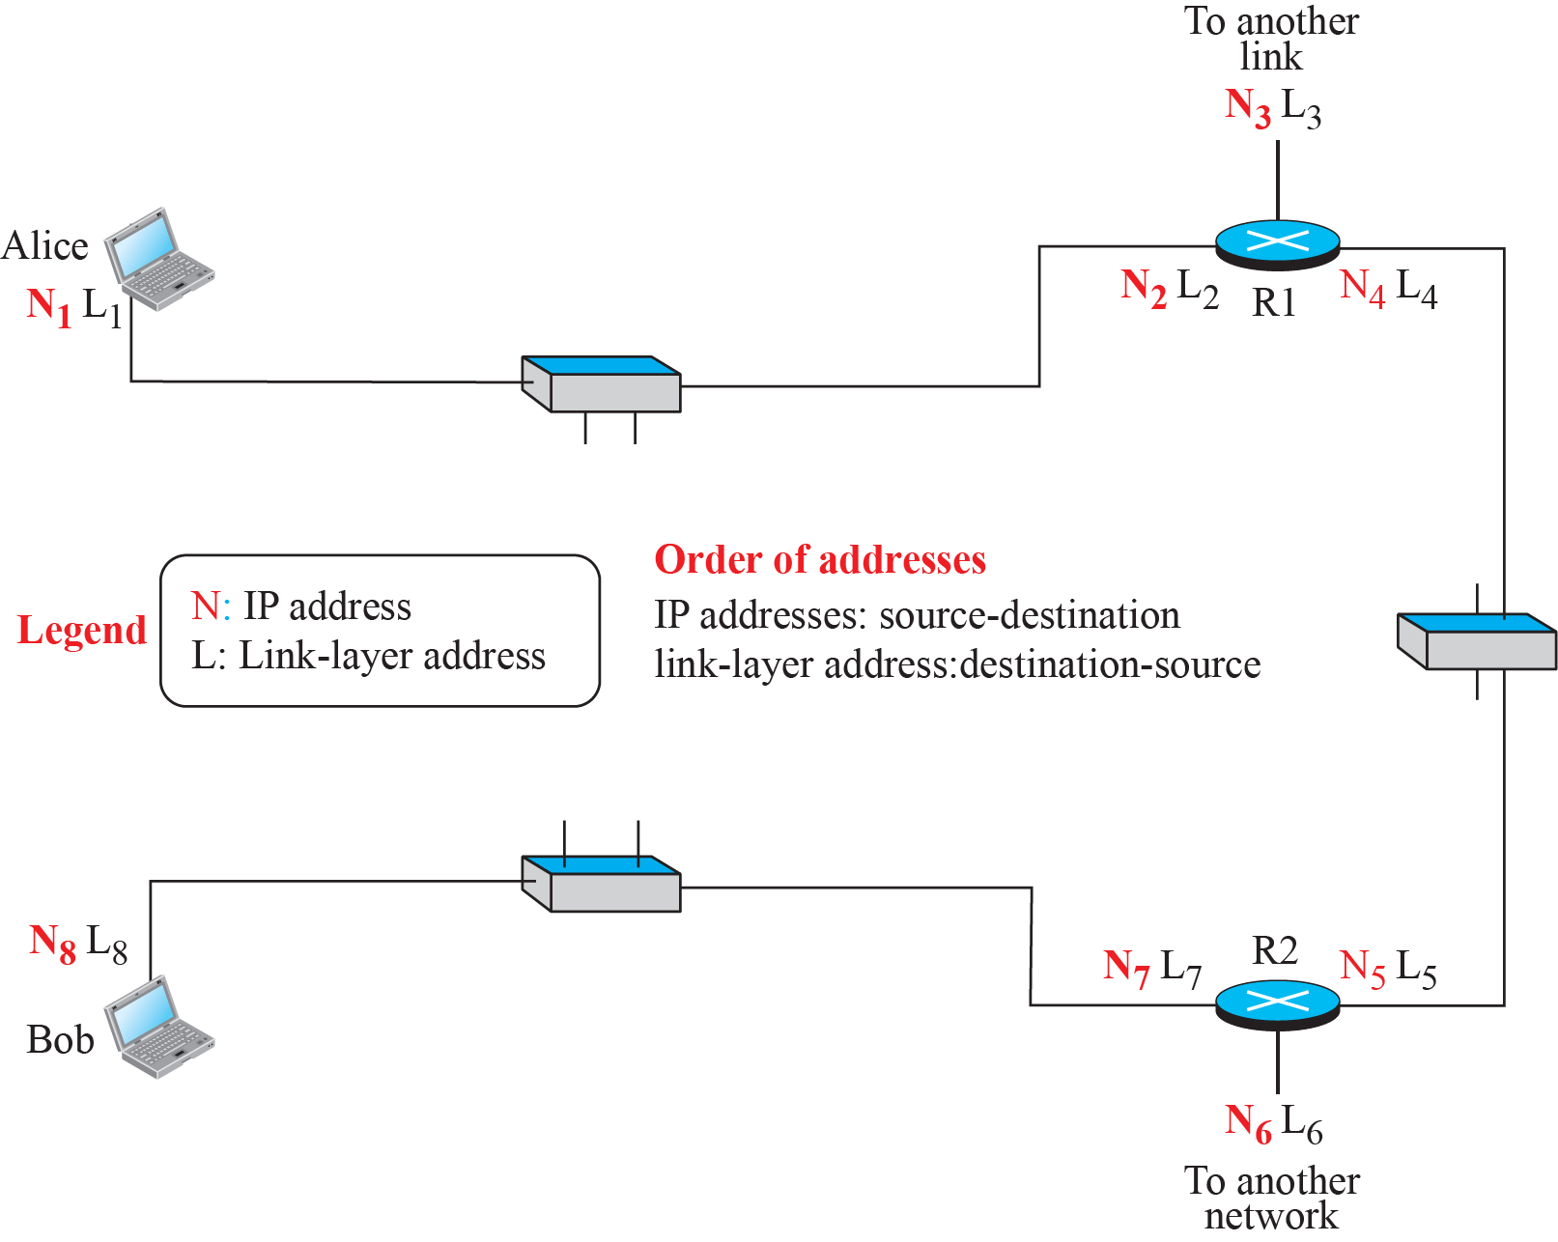
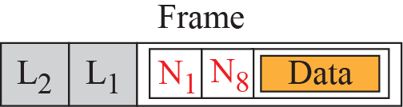
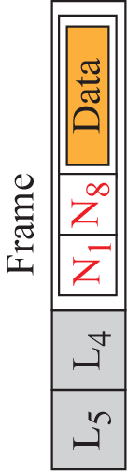
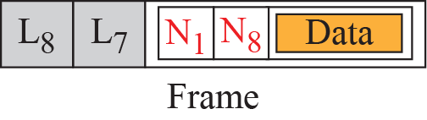
    9.2 Link-Layer Addressing
    9.2 Link-Layer Addressing
Link layer address
  Link address
  Physical address
  MAC address
Fig. 9.5 IP addresses and link-layer addresses in a small internet

Slide 9
    9.2 Link-Layer Addressing
    9.2.1 Three Types of Addresses
unicast,
multicast,
and broadcast

Slide 10
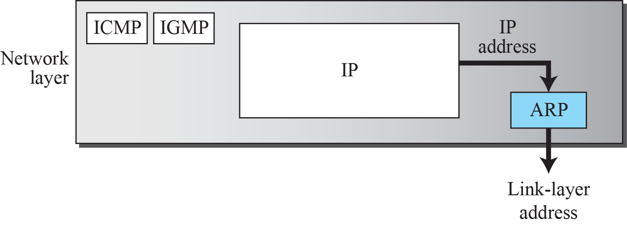
    9.2 Link-Layer Addressing
    9.2.2 Address Resolution Protocol (ARP)
is helpful in moving a frame through a link; we need the link-layer address of the next node
Fig. 9.6 Position of ARP in TCP/IP protocol suite

Slide 11
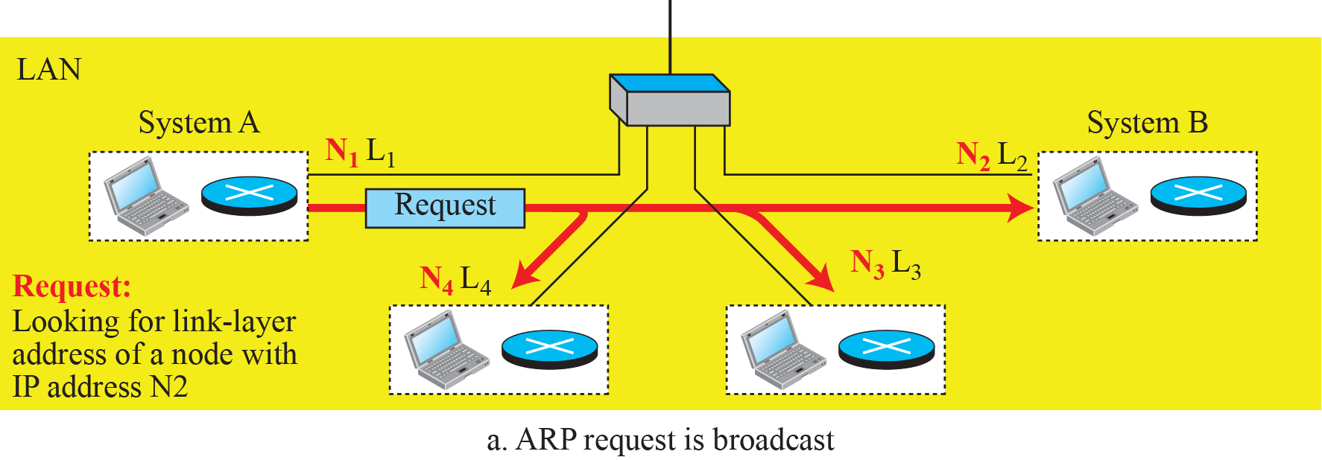
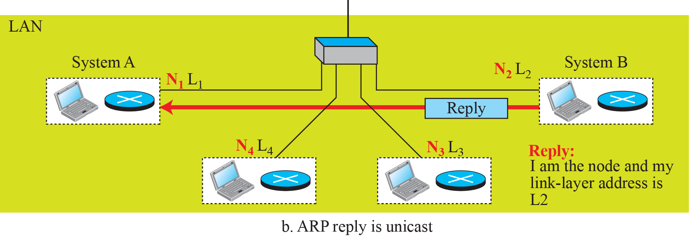
    9.2 Link-Layer Addressing
Fig. 9.7 ARP operation

Slide 12
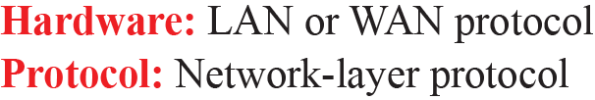
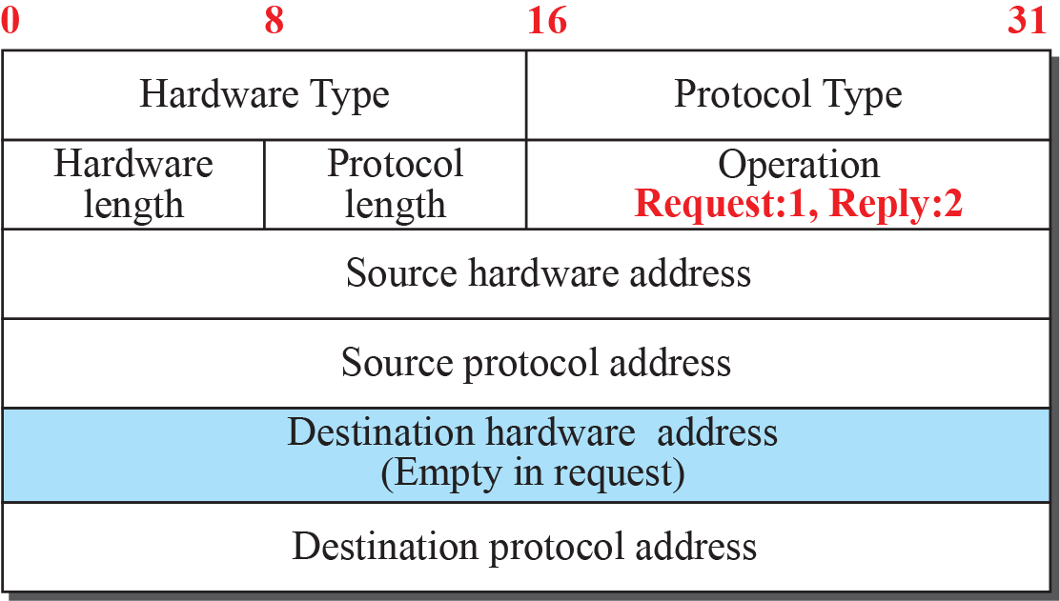
    9.2 Link-Layer Addressing
    Caching
The storing of information in a small, fast memory
    Packet Format
Fig. 9.8 ARP Packet

Slide 13
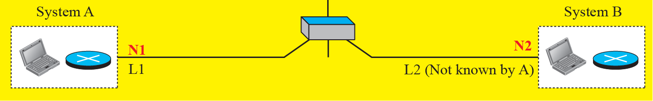
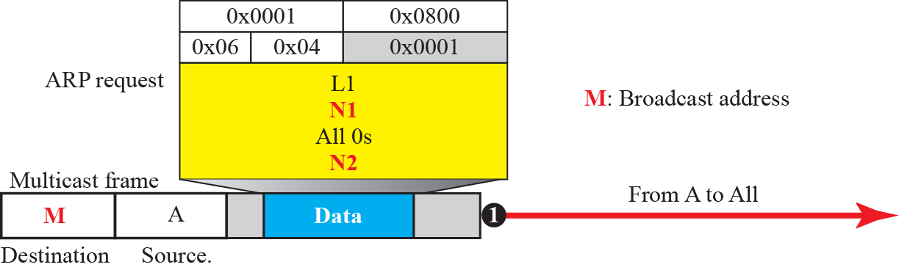
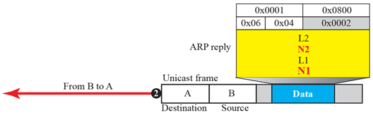
    9.2 Link-Layer Addressing
    Ex. 9.4
Fig. 9.9 Example 9.4

Slide 14
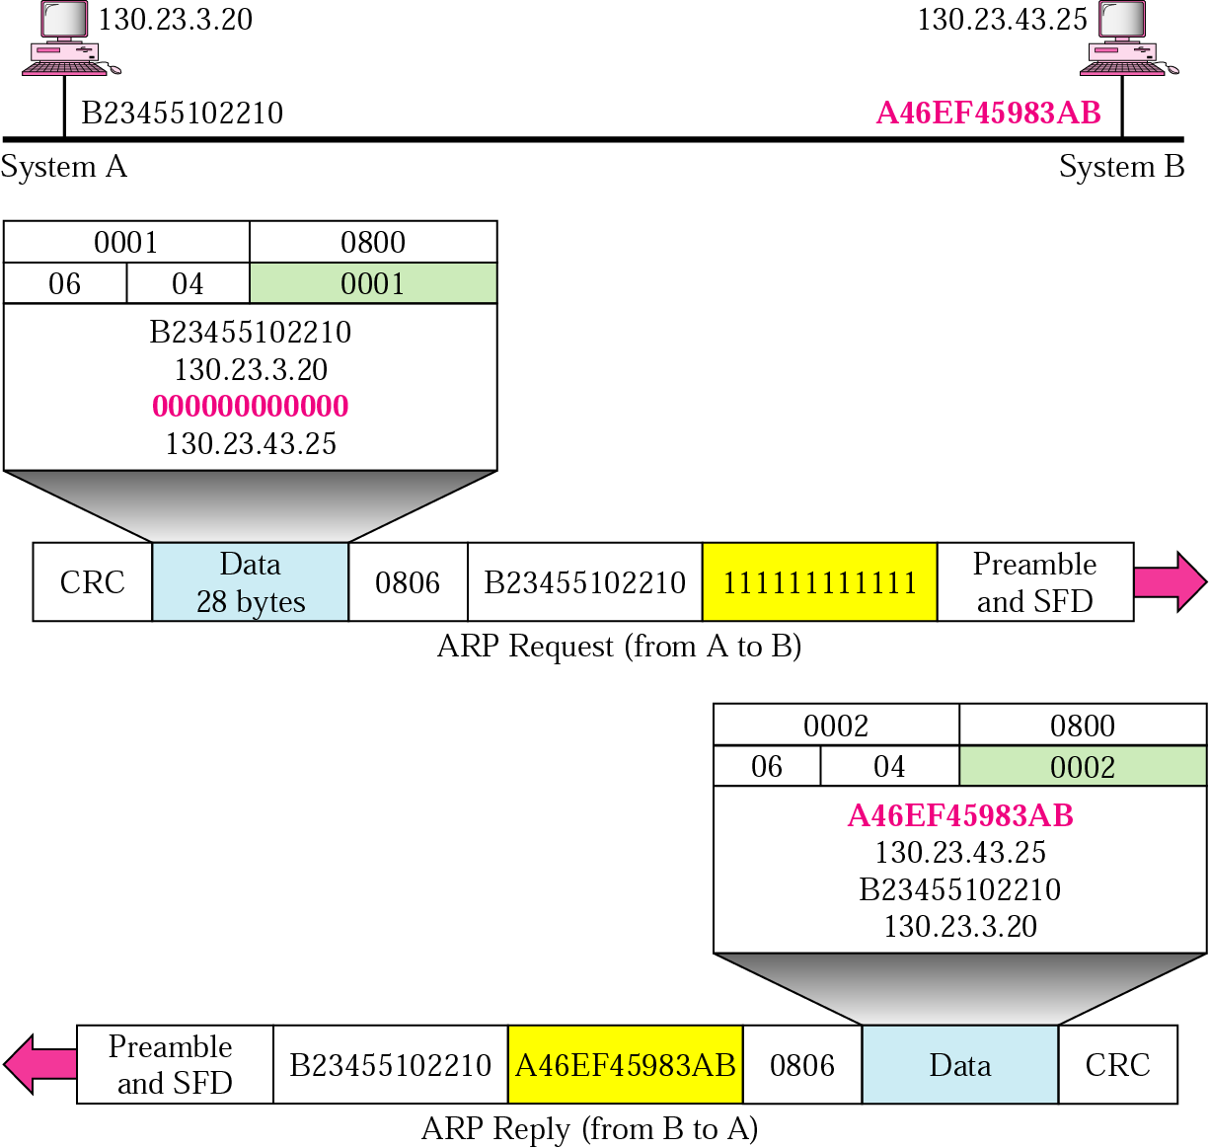
    9.2 Link-Layer Addressing

Slide 15
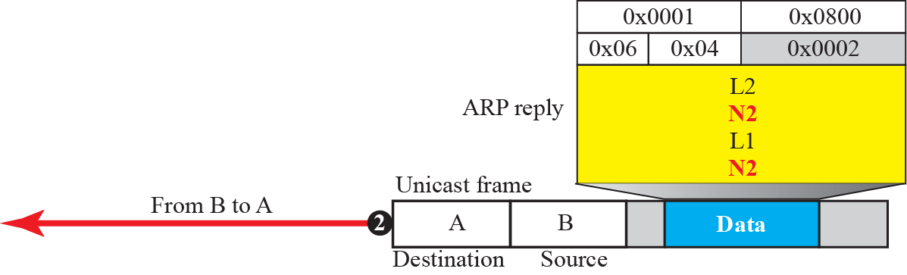
    9.2 Link-Layer Addressing
    Ex. 9.4
Fig. 9.9 Example 9.4

Slide 16
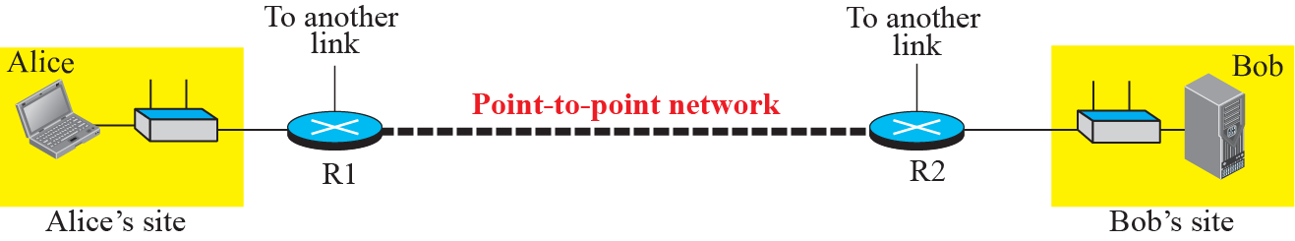
    9.2 Link-Layer Addressing
    9.2.3 An Example of Communication
Fig. 9.10 The internet for our example

Slide 17
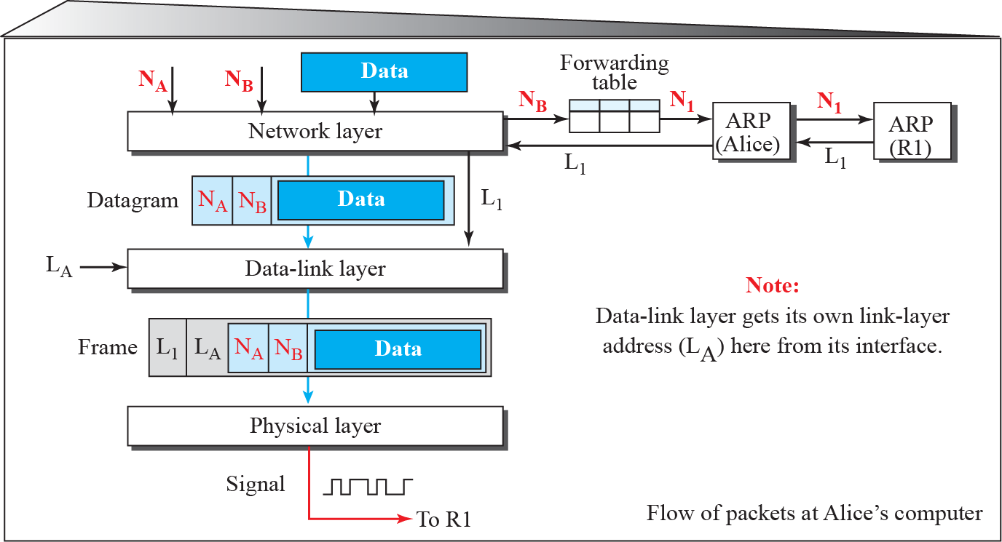
    9.2 Link-Layer Addressing
    Activities at Alice’s Site
Fig. 9.11 Flow of packets at Alice’s computer

Slide 18
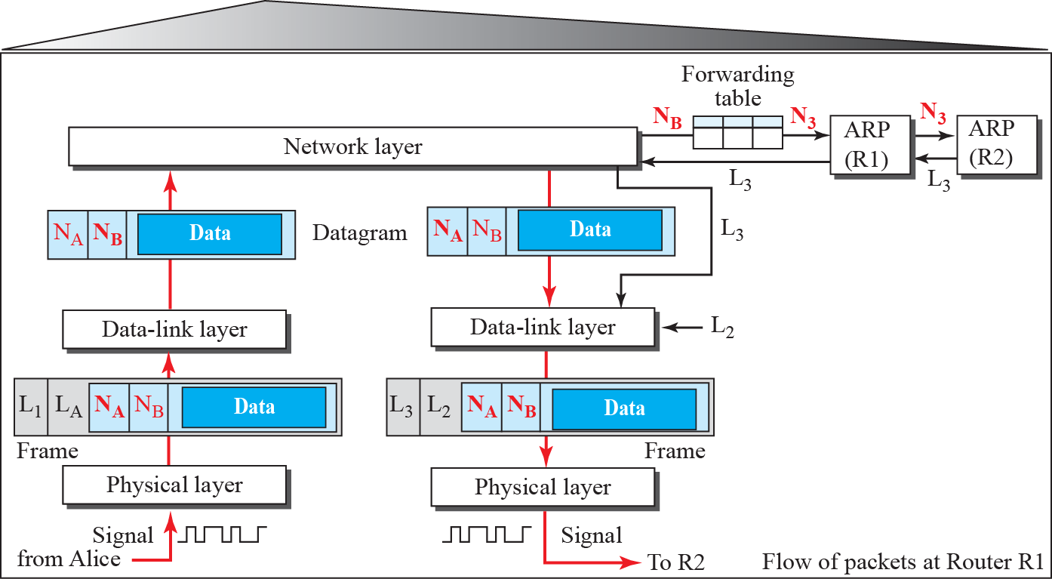
    9.2 Link-Layer Addressing
    Activities at Router R1
Fig. 9.12 Flow of activities at router R1

Slide 19
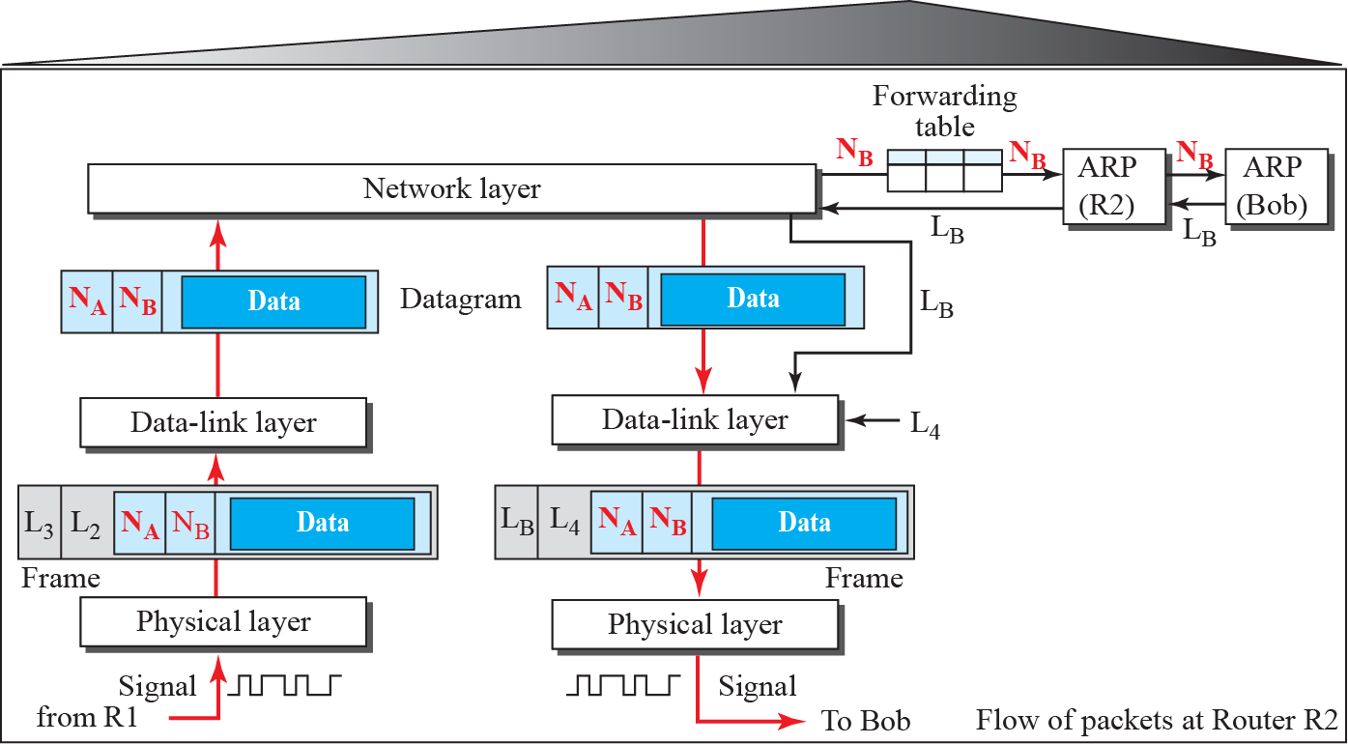
    9.2 Link-Layer Addressing
    Activities at Router R2
Fig. 9.13 Flow of activities at router R2

Slide 20
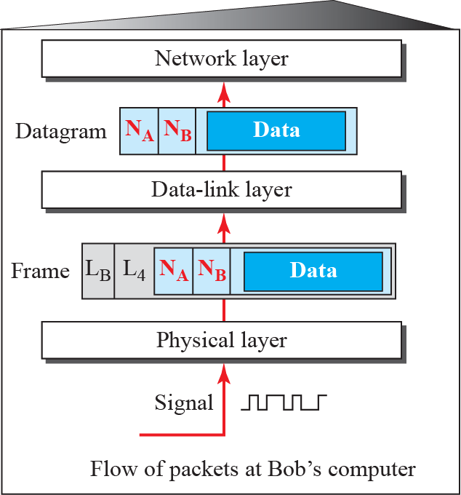
    9.2 Link-Layer Addressing
    Activities at Bob’s Site
Fig. 9.14 Flow of activities at Bob’s site

Slide 21
    Homework
Homework
Read textbook pp. 257-287
Next Lecture
Chapter 10. Error Detection and Correction

